Slide 1


Slide 2




Slide 3



TREE
IN
JAVA

Slide 4
TREE
A Tree is a recursive data structure containing the set of one or more data nodes where one node is designated as the root of the tree while the remaining nodes are called as the children of the root
The nodes other than the root node are partitioned into the non empty sets where each one of them is to be called sub-tree
Nodes of a tree either maintain a parent-child relationship between them or they are sister nodes
In a general tree, A node can have any number of children nodes but it can have only a single parent

Slide 5
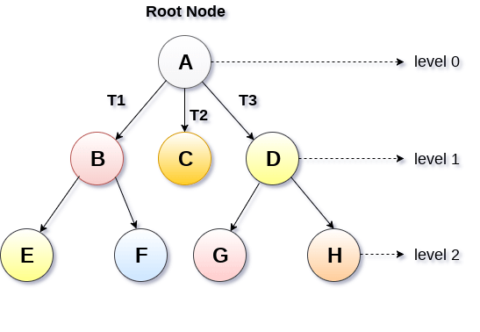
TREE

Slide 6
BASIC TERMINOLOGY
Root Node :The root node is the topmost node in the tree hierarchy. In other words, the root node is the one which doesn't have any parent
Sub Tree :If the root node is not null, the tree T1, T2 and T3 is called sub-trees of the root node
Leaf Node :The node of tree, which doesn't have any child node, is called leaf node. Leaf node is the bottom most node of the tree. There can be any number of leaf nodes present in a general tree. Leaf nodes can also be called external nodes
Path :The sequence of consecutive edges is called path. In the tree shown in the above image, path to the node E is A→ B → E

Slide 7
BASIC TERMINOLOGY
Ancestor node :An ancestor of a node is any predecessor node on a path from root to that node. The root node doesn't have any ancestors. In the tree shown in the above image, the node F have the ancestors, B and A
Degree :Degree of a node is equal to number of children, a node have. In the tree shown in the above image, the degree of node B is 2. Degree of a leaf node is always 0 while in a complete binary tree, degree of each node is equal to 2
Level Number :Each node of the tree is assigned a level number in such a way that each node is present at one level higher than its parent. Root node of the tree is always present at level 0

Slide 8
STATIC REPRESENTATION OF TREE
Dynamic representation of tree
#define MAXNODE 500 struct treenode { int root; int father; int son; int next; }
struct treenode { int root; struct treenode *father; struct treenode *son struct treenode *next; }

Slide 9
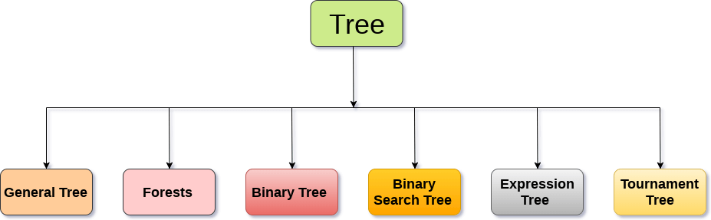
TYPES OF TREE
The tree data structure can be classified into six different categories

Slide 10
GENERAL TREE
General Tree stores the elements in a hierarchical order in which the top level element is always present at level 0 as the root element
All the nodes except the root node are present at number of levels
The nodes which are present on the same level are called siblings while the nodes which are present on the different levels exhibit the parent-child relationship among them
A node may contain any number of sub-trees
The tree in which each node contain 3 sub-tree, is called ternary tree

Slide 11
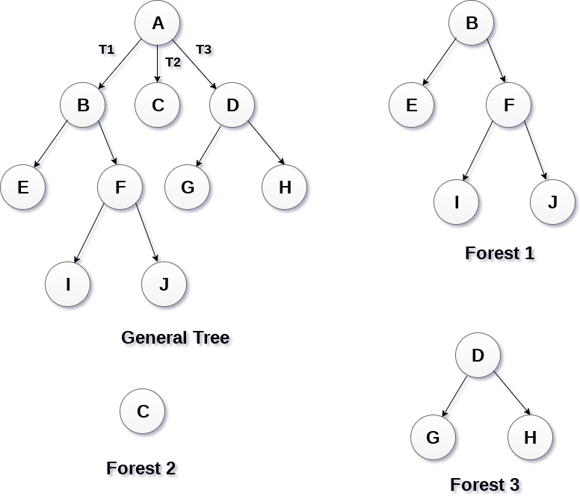
FORESTS
Forest can be defined as the set of disjoint trees which can be obtained by deleting the root node and the edges which connects root node to the first level node

Slide 12
BINARY TREE
Binary tree is a data structure in which each node can have at most 2 children
The node present at the top most level is called the root node. A node with the 0 children is called leaf node
Binary Trees are used in the applications like expression evaluation and many more

Slide 13
BINARY SEARCH TREE
Binary search tree is an ordered binary tree
All the elements in the left sub-tree are less than the root while elements present in the right sub-tree are greater than or equal to the root node element
Binary search trees are used in most of the applications of computer science domain like searching, sorting, etc

Slide 14
EXPRESSION TREE
Expression trees are used to evaluate the simple arithmetic expressions
Expression tree is basically a binary tree where internal nodes are represented by operators while the leaf nodes are represented by operands
Expression trees are widely used to solve algebraic expressions like (a+b)*(a-b). Consider the following example

Slide 15
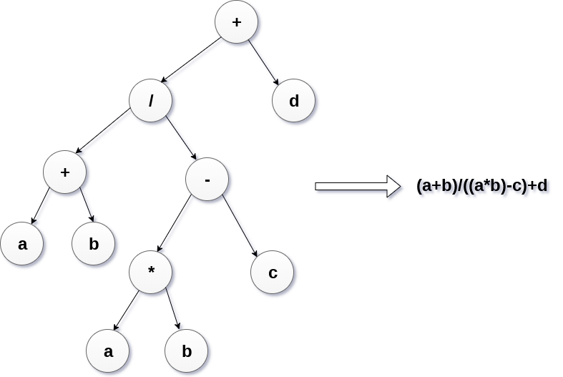
EXPRESSION TREE
Construct an expression tree by using the following algebraic expression
(a + b) / (a*b - c) + d

Slide 16
TOURNAMENT TREE
Tournament tree are used to record the winner of the match in each round being played between two players
Tournament tree can also be called as selection tree or winner tree. External nodes represent the players among which a match is being played while the internal nodes represent the winner of the match played
At the top most level, the winner of the tournament is present as the root node of the tree

Slide 17
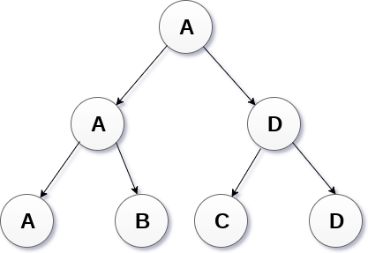
TOURNAMENT TREE
For example, tree .of a chess tournament being played among 4 players is shown as follows. However, the winner in the left sub-tree will play against the winner of right sub-tree

Slide 18
BINARY TREE
Binary Tree is a special type of generic tree in which, each node can have at most two children. Binary tree is generally partitioned into three disjoint subsets
Root of the node
Left sub-tree which is also a binary tree
Right binary sub-tree

Slide 19
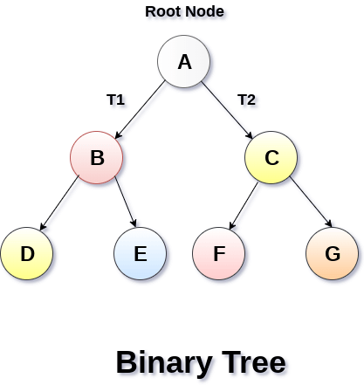
A BINARY TREE IS SHOWN IN THE FOLLOWING IMAGE

Slide 20
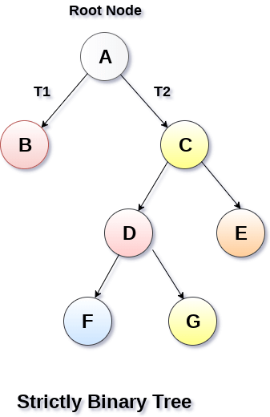
TYPES OF BINARY TREE
Strictly Binary Tree
In Strictly Binary Tree, every non-leaf node contain non-empty left and right sub-trees
In other words, the degree of every non-leaf node will always be 2. A strictly binary tree with n leaves, will have (2n - 1) nodes

Slide 21
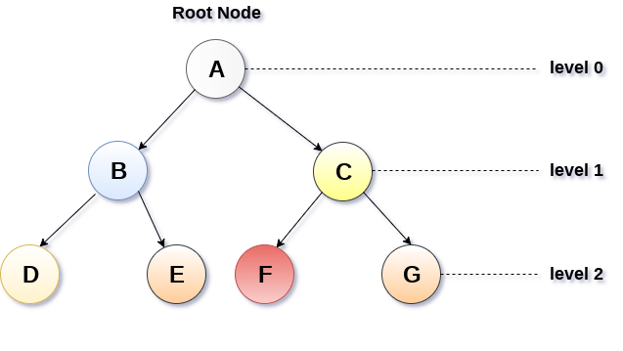
COMPLETE BINARY TREE
A Binary Tree is said to be a complete binary tree if all of the leaves are located at the same level d
A complete binary tree is a binary tree that contains exactly 2^l nodes at each level between level 0 and d
The total number of nodes in a complete binary tree with depth d is 2^{d+1}-1 where leaf nodes are 2^{d} while non-leaf nodes are 2^{d}-1

Slide 22
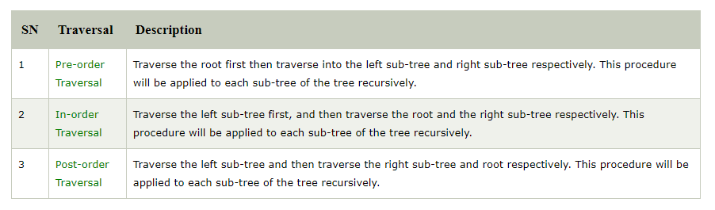
BINARY TREE TRAVERSAL

Slide 23
BINARY TREE REPRESENTATION
There are two types of representation of a binary tree
Linked Representation
In this representation, the binary tree is stored in the memory, in the form of a linked list where the number of nodes are stored at non-contiguous memory locations and linked together by inheriting parent child relationship like a tree
Every node contains three parts : pointer to the left node, data element and pointer to the right node
Each binary tree has a root pointer which points to the root node of the binary tree. In an empty binary tree, the root pointer will point to null

Slide 24
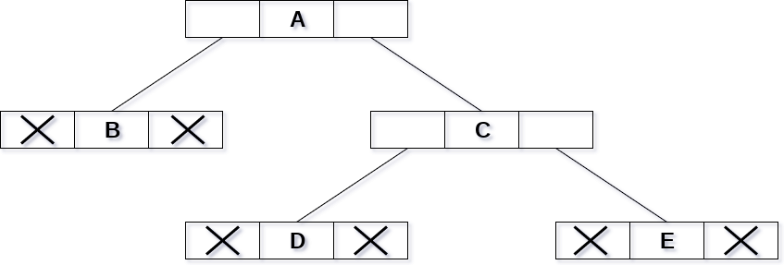
THE BINARY TREE GIVEN IN THE FIGURE BELOW
Notes:
in the above figure, a tree is seen as the collection of nodes where each node contains three parts : left pointer, data element and right pointer. Left pointer stores the address of the left child while the right pointer stores the address of the right child. The leaf node contains null in its left and right pointers.

Slide 25
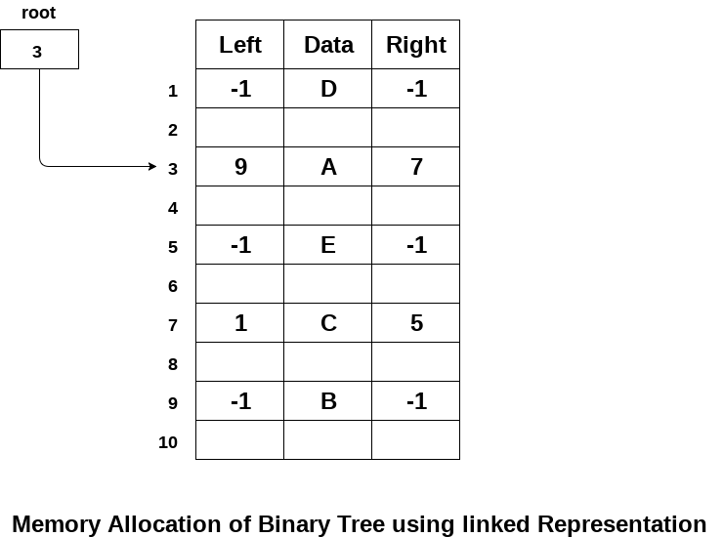
THE BINARY TREE GIVEN IN THE FIGURE BELOW
The following image shows about how the memory will be allocated for the binary tree by using linked representation. There is a special pointer maintained in the memory which points to the root node of the tree. Every node in the tree contains the address of its left and right child. Leaf node contains null in its left and right pointers

Slide 26
SEQUENTIAL REPRESENTATION
This is the simplest memory allocation technique to store the tree elements but it is an inefficient technique since it requires a lot of space to store the tree elements. A binary tree is shown in the following figure along with its memory allocation
In this representation, an array is used to store the tree elements. Size of the array will be equal to the number of nodes present in the tree. The root node of the tree will be present at the 1st index of the array. If a node is stored at ith index then its left and right children will be stored at 2i and 2i+1 location. If the 1st index of the array i.e. tree[1] is 0, it means that the tree is empty

Slide 27
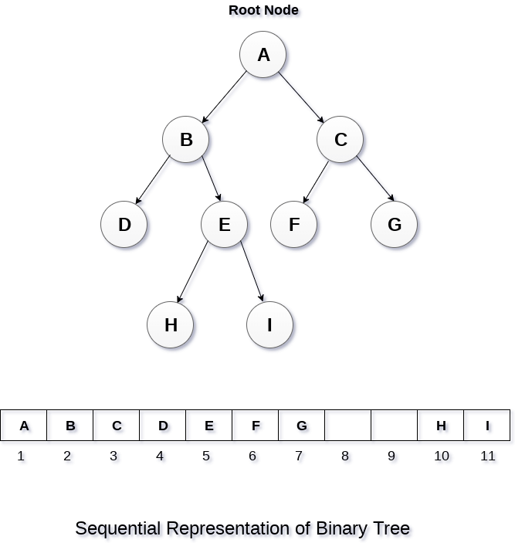
SEQUENTIAL REPRESENTATION

Slide 28
BINARY SEARCH TREE
Binary Search tree can be defined as a class of binary trees, in which the nodes are arranged in a specific order. This is also called ordered binary tree
In a binary search tree, the value of all the nodes in the left sub-tree is less than the value of the root
Similarly, value of all the nodes in the right sub-tree is greater than or equal to the value of the root
This rule will be recursively applied to all the left and right sub-trees of the root
Notes:
A Binary search tree is shown in the above figure. As the constraint applied on the BST, we can see that the root node 30 doesn't contain any value greater than or equal to 30 in its left sub-tree and it also doesn't contain any value less than 30 in its right sub-tree.

Slide 29
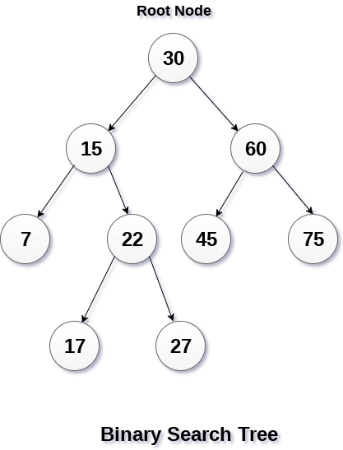
BINARY SEARCH TREE
Notes:
A Binary search tree is shown in the above figure. As the constraint applied on the BST, we can see that the root node 30 doesn't contain any value greater than or equal to 30 in its left sub-tree and it also doesn't contain any value less than 30 in its right sub-tree.

Slide 30
ADVANTAGES OF USING BINARY SEARCH TREE
Searching become very efficient in a binary search tree since, we get a hint at each step, about which sub-tree contains the desired element
The binary search tree is considered as efficient data structure in compare to arrays and linked lists. In searching process, it removes half sub-tree at every step

Slide 31
ADVANTAGES OF USING BINARY SEARCH TREE
Searching for an element in a binary search tree takes o(log₂n) time. In worst case, the time it takes to search an element is 0(n)
It also speed up the insertion and deletion operations as compare to that in array and linked list

Slide 32
QUESTION
Create the binary search tree using the following data elements
43, 10, 79, 90, 12, 54, 11, 9, 50
Insert 43 into the tree as the root of the tree
Read the next element, if it is lesser than the root node element, insert it as the root of the left sub-tree
Otherwise, insert it as the root of the right of the right sub-tree

Slide 33
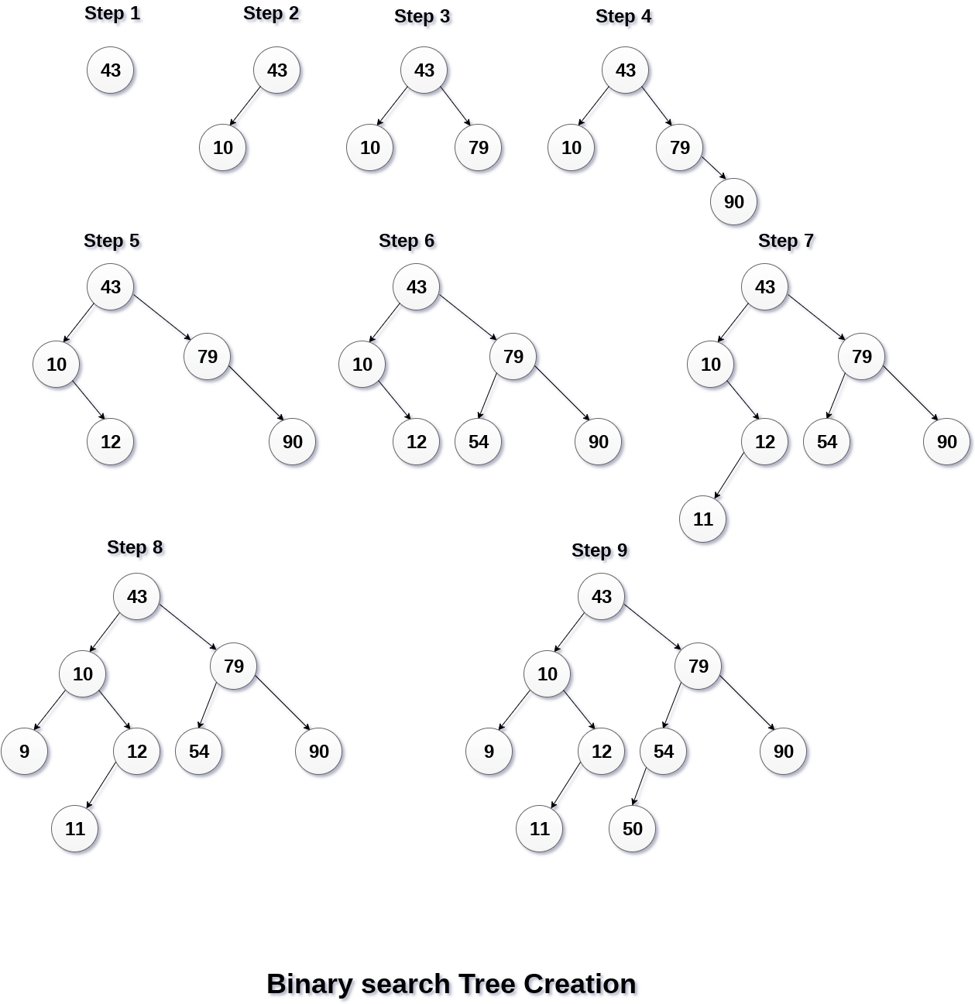
BINARY SEARCH TREE

Slide 34
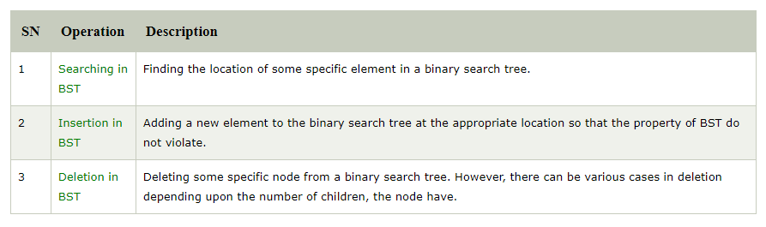
OPERATIONS ON BINARY SEARCH TREE
There are many operations which can be performed on a binary search tree

Slide 35
AVL TREE
AVL Tree can be defined as height balanced binary search tree in which each node is associated with a balance factor which is calculated by subtracting the height of its right sub-tree from that of its left sub-tree
Tree is said to be balanced if balance factor of each node is in between -1 to 1, otherwise, the tree will be unbalanced and need to be balanced
Balance Factor (k) = height (left(k)) - height (right(k))
If balance factor of any node is 1, it means that the left sub-tree is one level higher than the right sub-tree

Slide 36
AVL TREE
If balance factor of any node is 0, it means that the left sub-tree and right sub-tree contain equal height
If balance factor of any node is -1, it means that the left sub-tree is one level lower than the right sub-tree
An AVL tree is given in the following figure. We can see that, balance factor associated with each node is in between -1 and +1. therefore, it is an example of AVL tree.

Slide 37
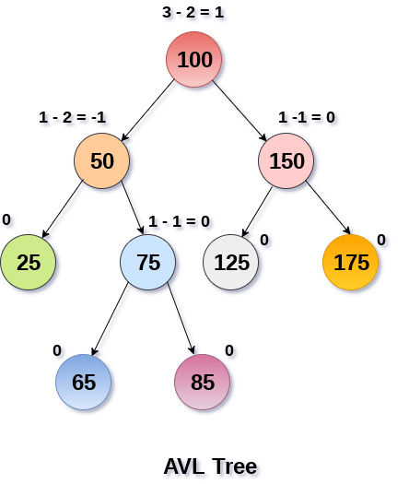
OPERATIONS ON AVL TREE

Slide 38
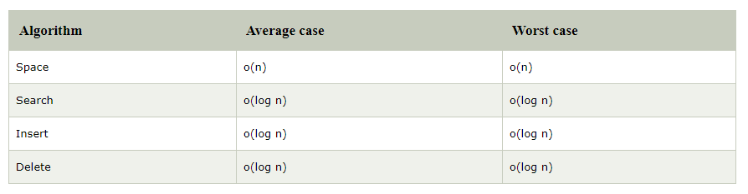
COMPLEXITY

Slide 39
OPERATIONS ON AVL TREE
Due to the fact that, AVL tree is also a binary search tree therefore, all the operations are performed in the same way as they are performed in a binary search tree
Searching and traversing do not lead to the violation in property of AVL tree. However, insertion and deletion are the operations which can violate this property and therefore, they need to be revisited

Slide 40
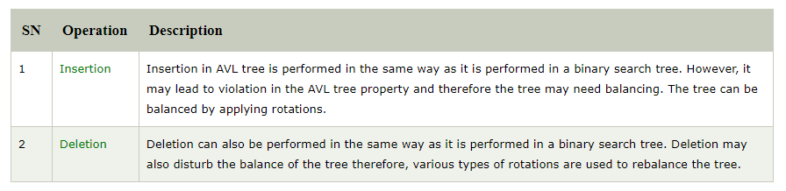
OPERATIONS ON AVL TREE

Slide 41
WHY AVL TREE ?
AVL tree controls the height of the binary search tree by not letting it to be skewed
The time taken for all operations in a binary search tree of height h is O(h). However, it can be extended to O(n) if the BST becomes skewed (i.e. worst case). By limiting this height to log n
AVL tree imposes an upper bound on each operation to be O(log n) where n is the number of nodes

Slide 42

THANK YOU

